Slide 1
Introduction
Objective: Analyze global COVID-19 spread using real-world medical data
Dataset Source: Johns Hopkins University CSSE COVID-19 data
Link: https://github.com/CSSEGISandData/COVID-19
Dataset Description:
Daily cumulative confirmed COVID-19 cases by country
Global coverage across 180+ countries
Time-series structure: January 2020 → Present
Techniques: EDA, Map Visualization, Aggregation Visualization, Interactive Visualization

Slide 2
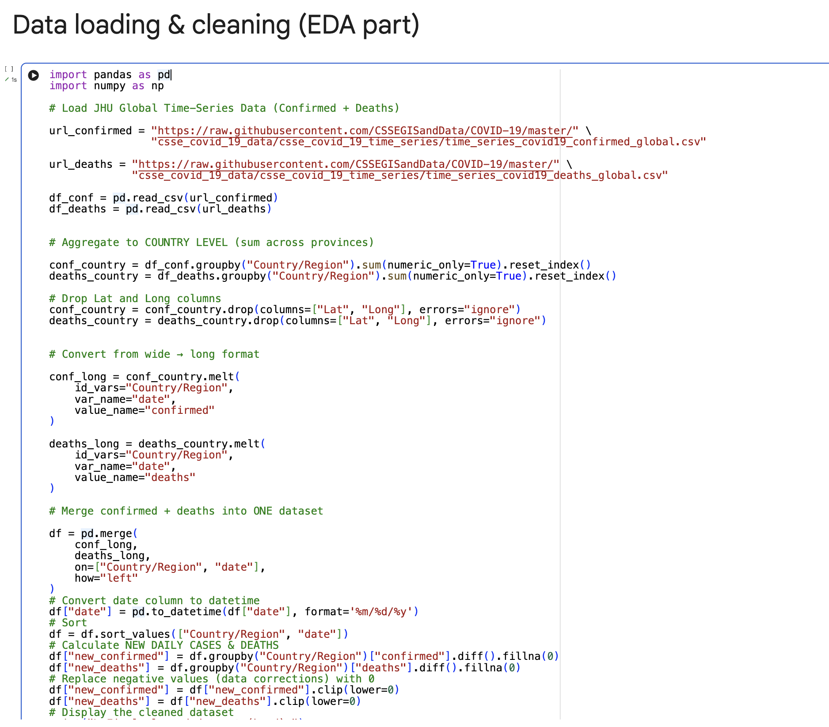
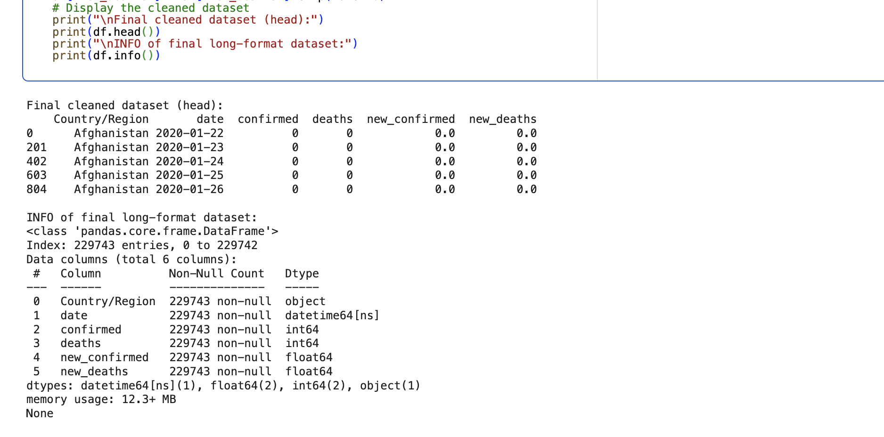
Data Loading & Cleaning
Loaded CSV directly from GitHub using pandas
Aggregated cases by Country/Region
Converted wide format → long format
Merged confirmed and deaths into a single dataset
Computed new daily cases and deaths using groupby-diff
Corrected negative values (reset to 0)
Prepared the latest-date snapshot for visualization

Slide 3
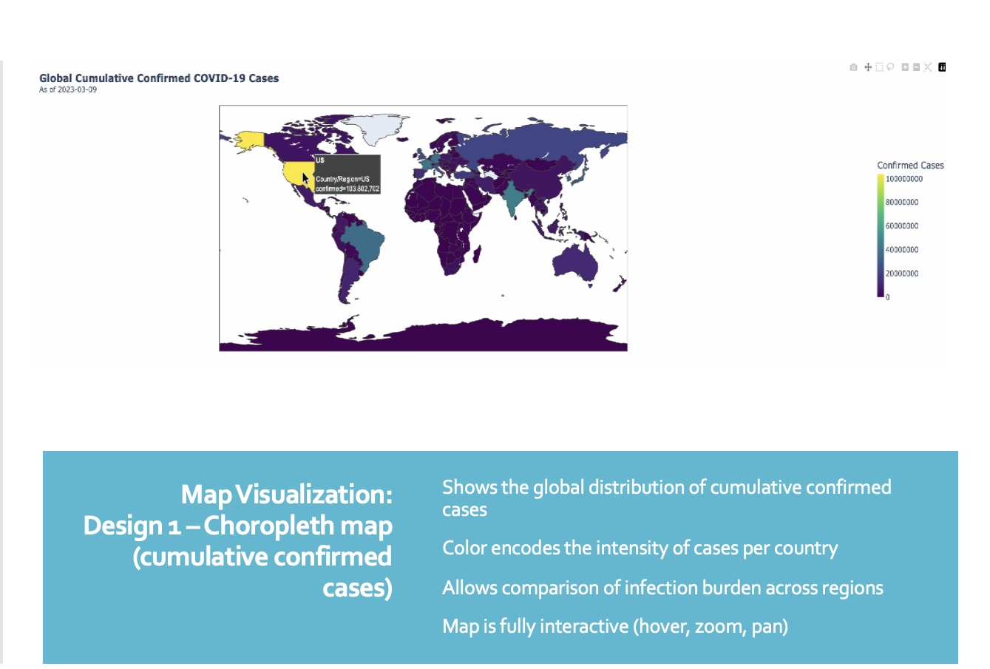

Slide 5
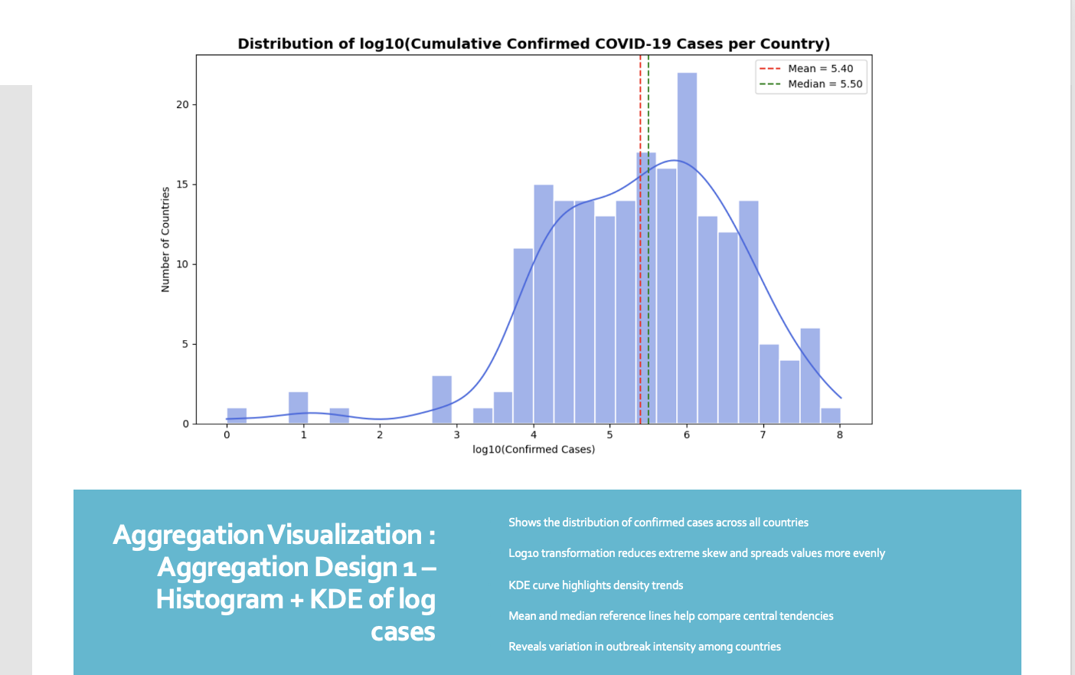

Slide 6
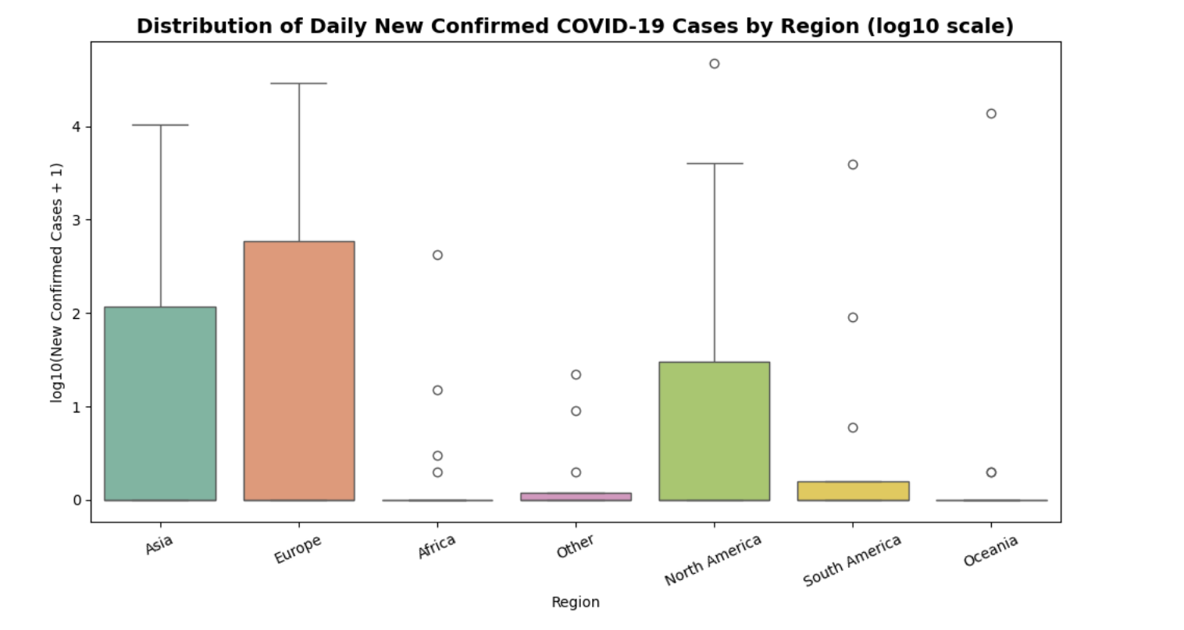
Aggregation Visualization: Design 2 – Box Plot
Groups countries by continent to compare regional outbreak patterns
Uses log10 transformation to handle large variation in new daily cases
Boxplot shows median, quartiles, and spread of new infections
Highlights regional differences in COVID-19 growth rates
Identifies regions with higher variability or more extreme spikes

Slide 7
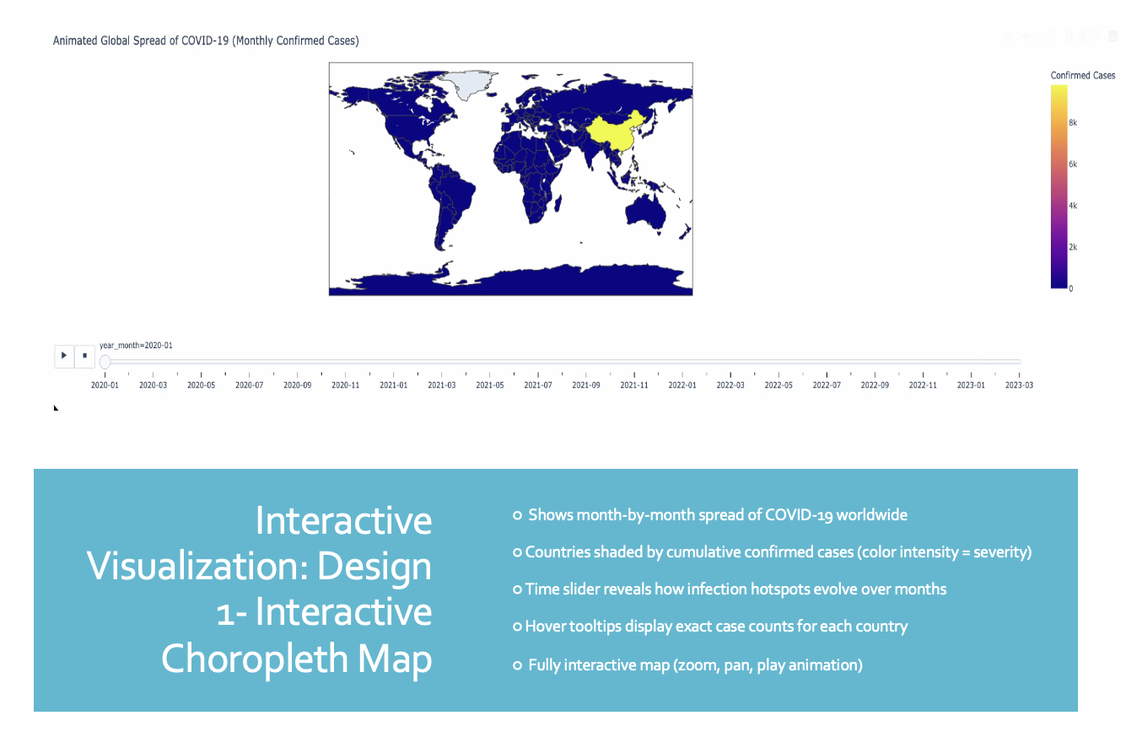

Slide 8
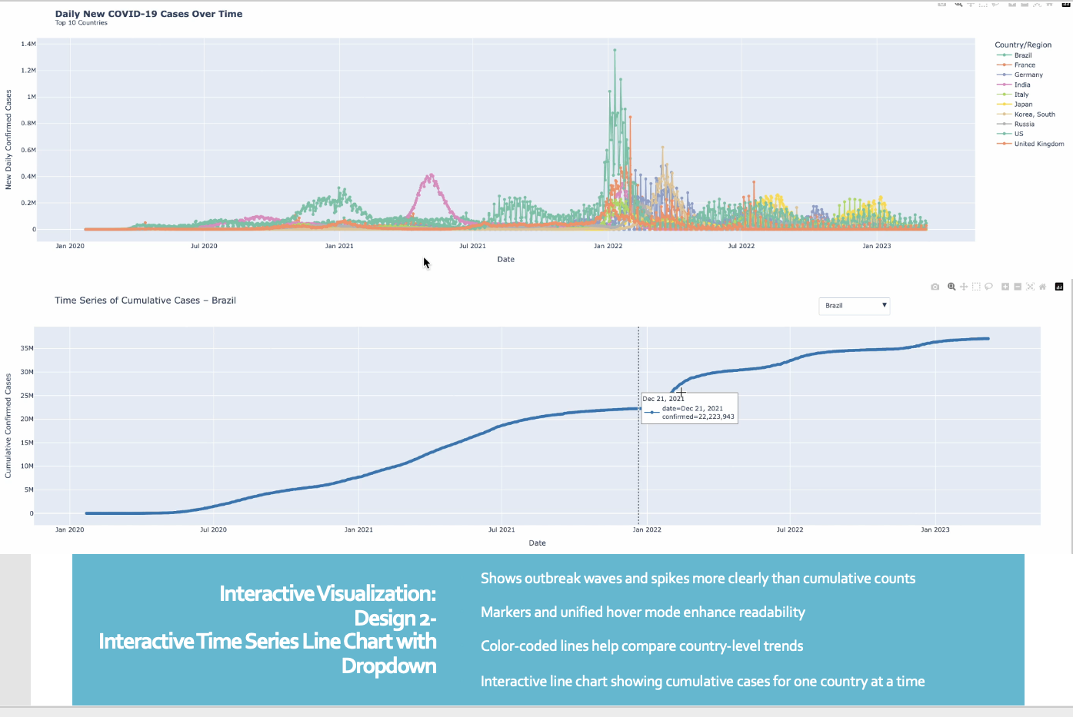

Slide 9
Conclusion
COVID-19 data reveals strong geographic differences
High case concentration in specific countries
Aggregation visualizations highlight uneven global spread
Interactive tools improve understanding of trends

